Slide 1

[Samsung PRISM] Weekly Review
AI/ML Based Network Device Software upgrade in SDN Controlled Network
Team
College Professor(s): Dr.P. PRAKASAM / prakasam.p@vit.ac.in
Students:
SAKSHI A. RAGHAVAN / sakshiraghavan.a2020@vitstudent.ac.in
JAYA SRI KRISHNA.S / jayasri.krishna2020@vitstudent.ac.in
JANARTHANAN.P.M / janarthanan.pm2020@vitstudent.ac.in
Department: ECE

Slide 2

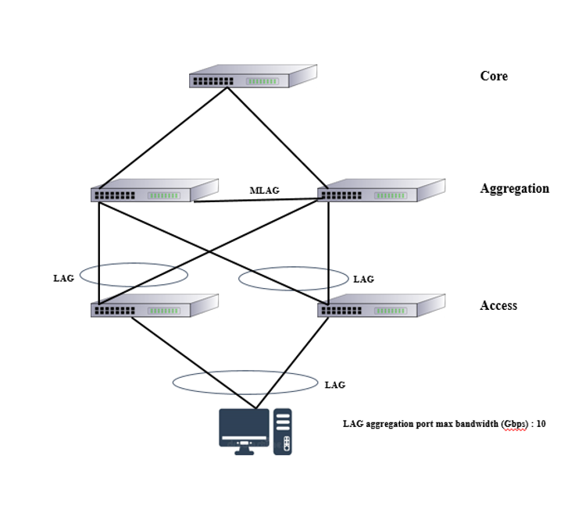
CSW23 | AI/ML Based Network Device Software upgrade in SDN Controlled Network
ARCHITECTURE
Srevatsa, Director
Vanraj, Manager
Notes:
-

Slide 3
Literature survey and study
Major Observations / Conclusions:
(provide details about your findings, experimental opinion – Use separate slide if necessary)
Xuyuntao Zhang, Shuaiyong Li, Cha Zhang,“Short-Term Prediction of SDN Network Traffic Based on CEEMDAN and Mixed Kernel Least Squares Support Vector Machine”, 2022 5th International Conference on Pattern Recognition and Artificial Intelligence (PRAI), ISBN 978-1-6654-9916-3, 978-1-6654-9915-6, (http://surl.li/dmgcg)
PUBLICATION YEAR: 2022
The main contribution of the paper includes:
The paper proposes a combined prediction model combining decomposition algorithm, hybrid kernel least squares support vector machine, and optimization algorithm, considering the characteristics of network traffic such as nonlinearity and non-smoothness.
Firstly, the original data series is decomposed into a series of Intrinsic Mode Function (IMF) using the Complete Ensemble Empirical Mode Decomposition with Adaptive Noise (CEEMDAN) to smooth the series.
Then, the fuzzy C-mean algorithm (FCM) is used to classify each component into three classes based on its amplitude-frequency characteristics.
Next, based on the different characteristics of the kernel functions, least-squares support vector machine (LSSVM) prediction models with corresponding kernel functions are constructed for each class of components, and the parameters of each model are optimized using the artificial bee colony algorithm (ABC). Finally, the prediction results of each component are cumulatively reconstructed to obtain the final prediction results. Through experimental comparison, the prediction accuracy of the proposed model (CEEMDAN-FCM-LSSVM-ABC) is better than that of CEEMDAN-LSSVM, EMD-LSSVM, LSSVM, and other models.

Slide 4
Literature survey and study
Major Observations / Conclusions:
(provide details about your findings, experimental opinion – Use separate slide if necessary)
Richard Etengu, Saw ChinTan, Teong Che Chuah, Jaime Galan-Jimenez, “Deep Learning-Assisted Traffic Prediction in Hybrid SDN/OSPF Backbone Networks”, NOMS 2022-2022 IEEE/IFIP Network Operations and Management Symposium, ISBN: 978-1-6654-0601-7, (http://surl.li/dmgdu )
PUBLICATION YEAR: 2022
The paper’s gist:
Owing to the linear nature of network design, generally typified by manual control plane forwarding design, current frameworks are incapable of performing accurate traffic prediction over datasets in modern non-recurrent large-sized networks.
To address this issue, deep learning (DL) methods have recently been proposed as a possible solution. But, deciding the most appropriate DL models to be employed for accurate TM prediction is still a challenge.
This paper proposes an improved DL framework that utilizes different dimensionality feature reduction techniques to perform short-term TM prediction in SDN networks.
The two dimensionality reduction techniques required to perform feature reduction for the DL model are correlation component analysis (CCA) and principal component analysis (PCA). Investigational results show that the proposed method can achieve more accurate forecast of link traffic in comparison to the traditional baseline machine learning frameworks.

Slide 5
Literature survey and study
Major Observations / Conclusions:
(provide details about your findings, experimental opinion – Use separate slide if necessary)
Abdullah Baz, “Bayesian Machine Learning Algorithm for Flow Prediction in SDN Switches” 2018 1st International Conference on Computer Applications & Information Security (ICCAIS): ISBN: 978-1-5386-4427-0
(http://surl.li/dmgfa)
The paper’s gist:
Segregation of data and control plans impose latency and overheads to SDN-based networks as a Networking Function Device (NFD aka Switch) needs to consult the controller how to handle each traffic.
In order to overcome such shortcoming of SDN, this paper makes use of the Bayesian Machine Learning (BML) to allow switches to infer the underlying stochastic process by which controller classifies packets into flows.
Based on this inference a switch can assign those packets whose flows are not given previously by the controller to the most appropriate flow.
Extensive simulation conducted to assess the performance of the proposed algorithm highlights its advantages compared to the standard mechanism defined in the-state-of-the-art SDN implementation.

Slide 6
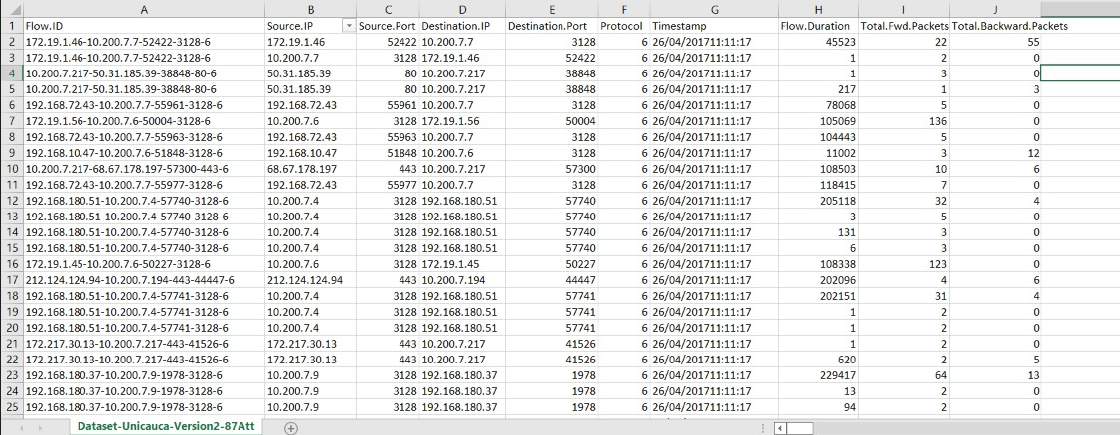
Literature survey and study
Major Observations / Conclusions:
(provide details about your findings, experimental opinion – Use separate slide if necessary)
DATASET FOUND:
Site:
https://www.kaggle.com/datasets/jsrojas/ip-network-traffic-flows-labeled-with-87-apps

Slide 7
Queries
Challenges :
(Discuss in the form of bullets, what are the next action steps, any road blocks / bottlenecks)

Slide 8
Thank you

